Slide 1

Securing the
Expanded Network
Medium-Sized Switched Network Construction
© 2007 Cisco Systems, Inc. All rights reserved.
ICND2 v1.0—2-1
The PDF files and any printed representation for this material are the property of Cisco Systems, Inc., for the sole use by Cisco employees for personal study. The files or printed representations may not be used in commercial training, and may not be distributed for purposes other than individual self-study.

Slide 2
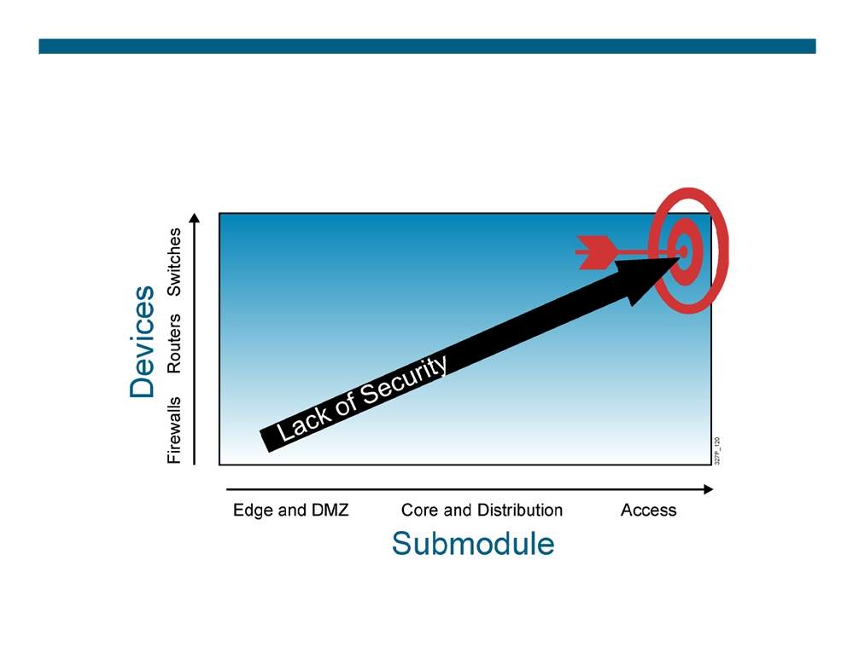
Overview of Switch Security
© 2007 Cisco Systems, Inc. All rights reserved.
ICND2 v1.0—2-2
The PDF files and any printed representation for this material are the property of Cisco Systems, Inc., for the sole use by Cisco employees for personal study. The files or printed representations may not be used in commercial training, and may not be distributed for purposes other than individual self-study.

Slide 3

Recommended Practices: New Switch Equipment
ƒ Consider or establish organizational security policies. ƒ Secure switch devices:
- Secure switch access. - Secure switch protocols.
- Mitigate compromises through switches.
© 2007 Cisco Systems, Inc. All rights reserved.
ICND2 v1.0—2-3
The PDF files and any printed representation for this material are the property of Cisco Systems, Inc., for the sole use by Cisco employees for personal study. The files or printed representations may not be used in commercial training, and may not be distributed for purposes other than individual self-study.

Slide 4
Recommended Practices: Switch Security
ƒ Secure switch access: - Set system passwords.
- Secure physical access to the console. - Secure access via Telnet.
- Use SSH when possible. - Disable HTTP.
- Configure system warning banners. - Disable unneeded services. - Use syslog if available.
© 2007 Cisco Systems, Inc. All rights reserved.
ICND2 v1.0—2-4
The PDF files and any printed representation for this material are the property of Cisco Systems, Inc., for the sole use by Cisco employees for personal study. The files or printed representations may not be used in commercial training, and may not be distributed for purposes other than individual self-study.

Slide 5
Recommended Practices: Switch Security (Cont.)
ƒ Secure switch protocols:
- Trim Cisco Discovery Protocol and use only as needed. - Secure spanning tree.
ƒ Mitigate compromises through a switch: - Take precautions for trunk links. - Minimize physical port access.
- Establish standard access-port configuration for both unused and used ports.
© 2007 Cisco Systems, Inc. All rights reserved.
ICND2 v1.0—2-5
The PDF files and any printed representation for this material are the property of Cisco Systems, Inc., for the sole use by Cisco employees for personal study. The files or printed representations may not be used in commercial training, and may not be distributed for purposes other than individual self-study.

Slide 6
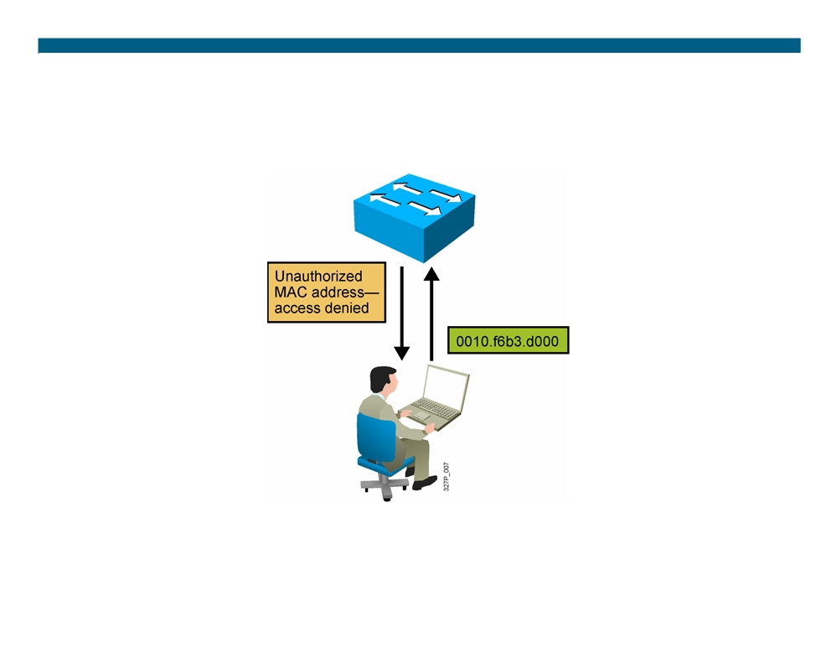
Port Security
Port security restricts port access by MAC address.
© 2007 Cisco Systems, Inc. All rights reserved.
ICND2 v1.0—2-6
The PDF files and any printed representation for this material are the property of Cisco Systems, Inc., for the sole use by Cisco employees for personal study. The files or printed representations may not be used in commercial training, and may not be distributed for purposes other than individual self-study.

Slide 7
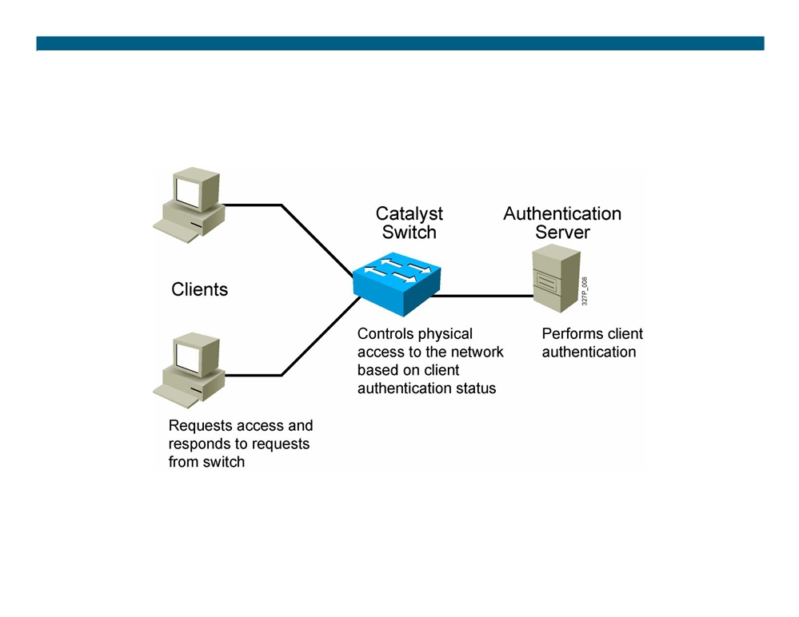
802.1X Port-Based Authentication
Network access through the switch requires authentication.
© 2007 Cisco Systems, Inc. All rights reserved.
ICND2 v1.0—2-7
The PDF files and any printed representation for this material are the property of Cisco Systems, Inc., for the sole use by Cisco employees for personal study. The files or printed representations may not be used in commercial training, and may not be distributed for purposes other than individual self-study.

Slide 8
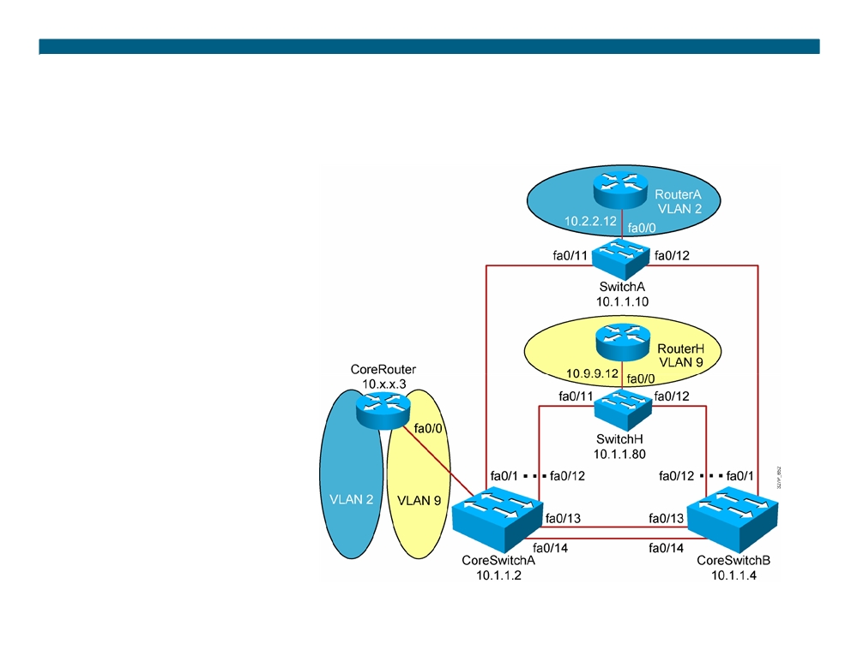
Visual Objective 2-1: Configuring Expanded Switched Networks
Subnet
VLAN Devices
10.1.1.0
1
Core Switches, CoreRouter, SwitchX
10.2.2.0
2
CoreRouter, RouterA
10.3.3.0
3
CoreRouter, RouterB
10.4.4.0
4
CoreRouter, RouterC
10.5.5.0
5
CoreRouter, RouterD
10.6.6.0
6
CoreRouter, RouterE
10.7.7.0
7
CoreRouter, RouterF
10.8.8.0
8
CoreRouter, RouterG
10.9.9.0
9
CoreRouter, RouterH
© 2007 Cisco Systems, Inc. All rights reserved.
ICND2 v1.0—2-8 The PDF files and any printed representation for this material are the property of Cisco Systems, Inc., for the sole use by Cisco employees for personal study. The files or printed representations may not be used in commercial training, and may not be distributed for purposes other than individual self-study.

Slide 9
Summary
ƒ Follow recommended practices for securing your switched topology by using passwords, deactivating unused ports, configuring authentication, and using port security. ƒ To secure a switch device, you must secure access to the switch and the protocols that the switch uses.
© 2007 Cisco Systems, Inc. All rights reserved.
ICND2 v1.0—2-9
The PDF files and any printed representation for this material are the property of Cisco Systems, Inc., for the sole use by Cisco employees for personal study. The files or printed representations may not be used in commercial training, and may not be distributed for purposes other than individual self-study.

Slide 10

© 2007 Cisco Systems, Inc. All rights reserved.
ICND2 v1.0—2-10 The PDF files and any printed representation for this material are the property of Cisco Systems, Inc., for the sole use by Cisco employees for personal study. The files or printed representations may not be used in commercial training, and may not be distributed for purposes other than individual self-study.

